Slide 1
Muon Spin Relaxation
a probe to atomic magnetic structure

Slide 2
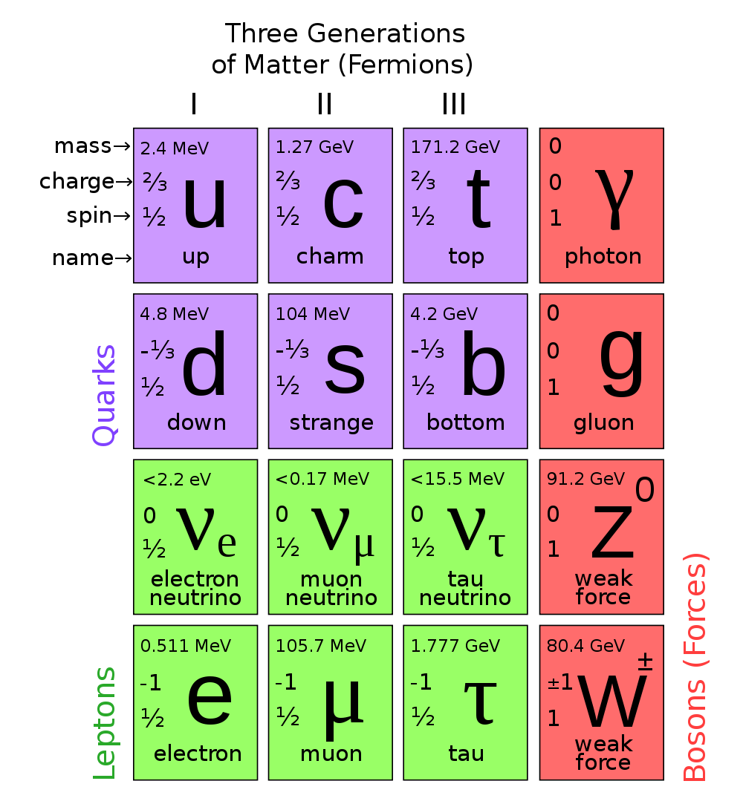
Lepton
Muon is a heavier version of electron
Muon is unstable with life time ~ 2.2 microsecond
Image from http://www.controlyourcash.com/wp-content/uploads/2013/07/1000px-Standard_Model_of_Elementary_Particles.svg_.png

Slide 3
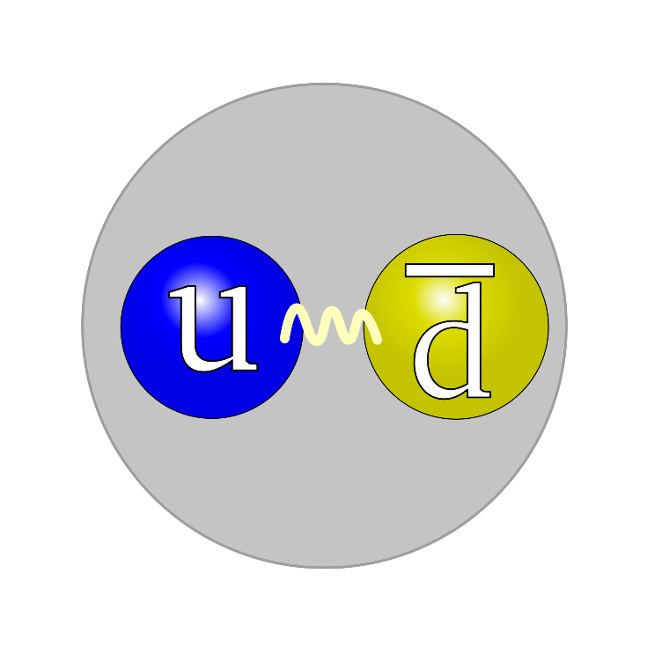
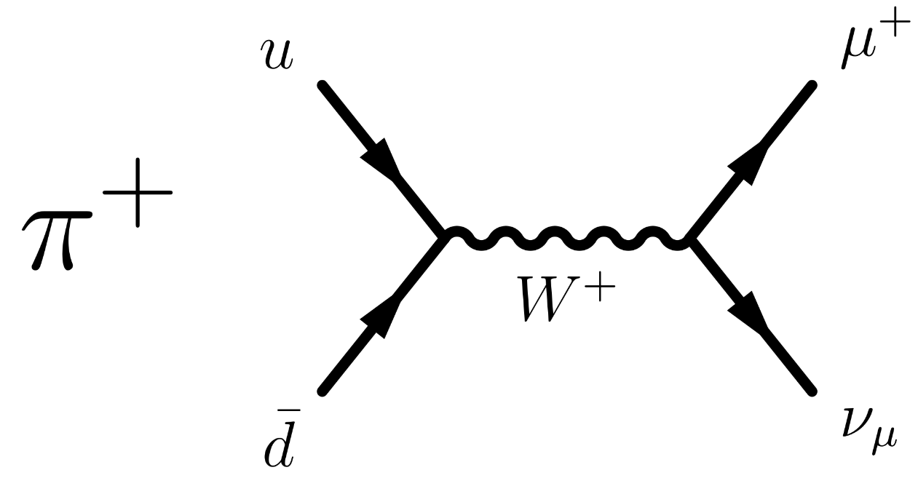
How to Create Muon?
We need Pion first.
Image from http://upload.wikimedia.org/wikipedia/commons/thumb/6/62/Quark_structure_pion.svg/2000px-Quark_structure_pion.svg.png

Slide 4
How to Create Muon?
We need Pion first. How to create pion then?!

Slide 5
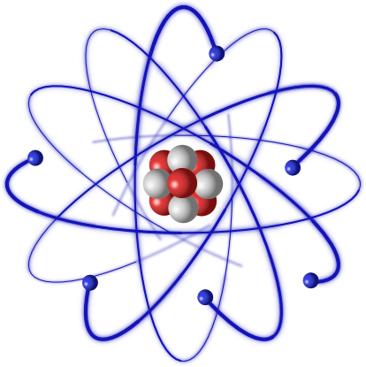
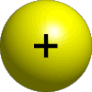

How to Create Muon?
We need Pion first. How to create pion then?!
$$Proton+Proton →Proton+Neutron+ π^{+}$$
$$Proton+Neutron →Neutron+Neutron+ π^{+}$$
Pion
600~800 MeV
Carbon Atom
Why carbon?
Image from http://myriverside.sd43.bc.ca/isaiahk-2013/files/2014/10/6745357_orig-2fcrpfj.png

Slide 6
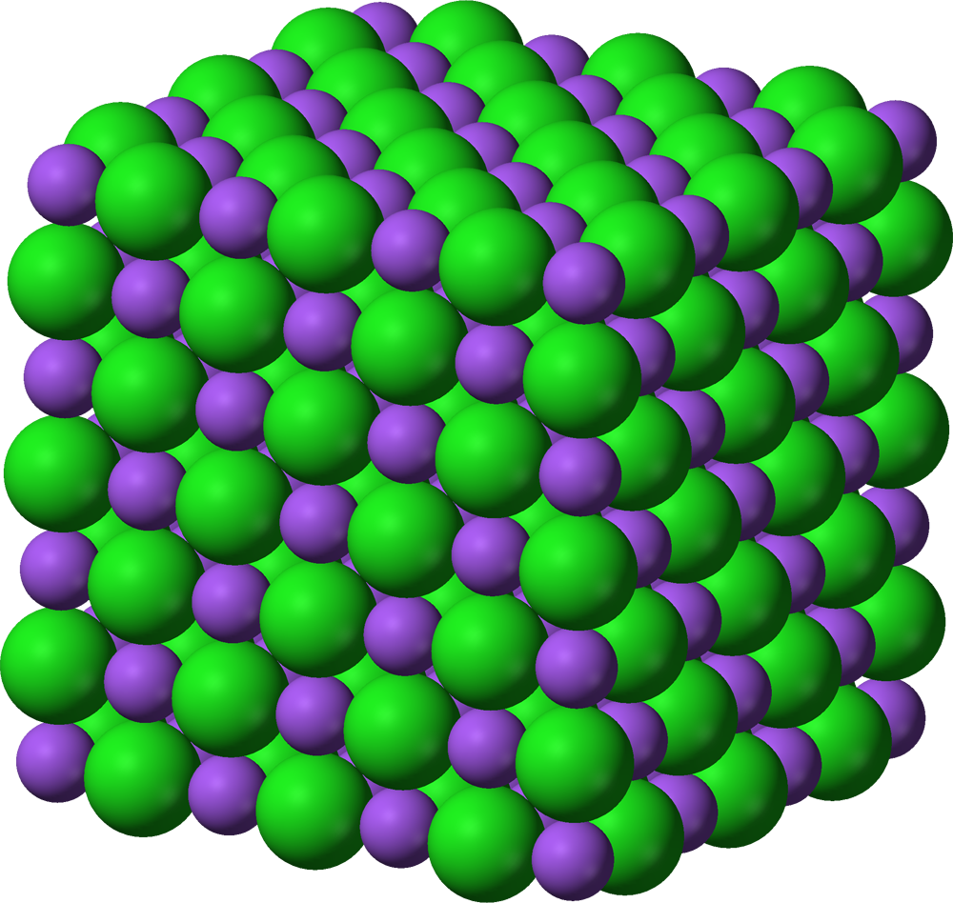

Muon Implementation
Once we have muon, we launch them into our sample.
$$μ^{+}$$
Muons lose their kinetic energy very quickly to inelastic scattering with electrons, electron capture, and ionization of atom.
Muons stop uniformly in sample

Slide 7
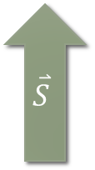


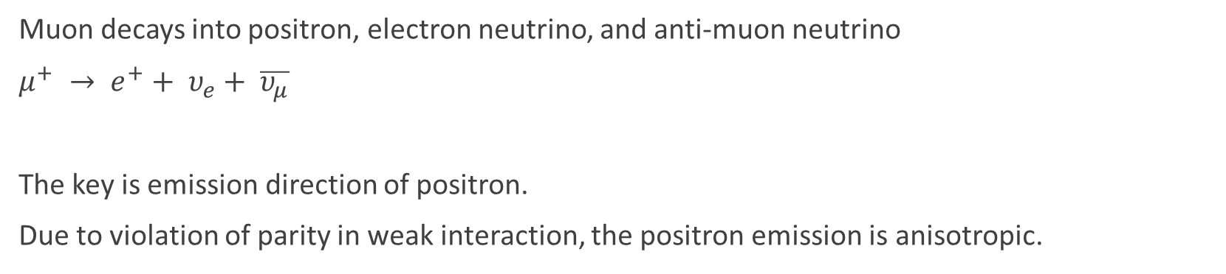
Muons come to rest (At lattice site)
Muon decays into positron, electron neutrino, and anti-muon neutrino
$μ^{+} → e^{+}+ υ_{e}+ \overline{υ_{μ}}$
The key is emission direction of positron.
Due to violation of parity in weak interaction, the positron emission is anisotropic.
$$\overset{⃑}{S}$$
$$Simplified Probabilty of Positron Emission→ W\left(θ\right) dθ=1+\frac{Cos\left(θ\right)}{3}P\left(t\right)dθ$$
$$θ$$
$$μ^{+}$$
The intensity of emission is angle and time dependent on spin polarization direction of muon
Positron signal is strongest along the direction of muon polarization

Slide 8
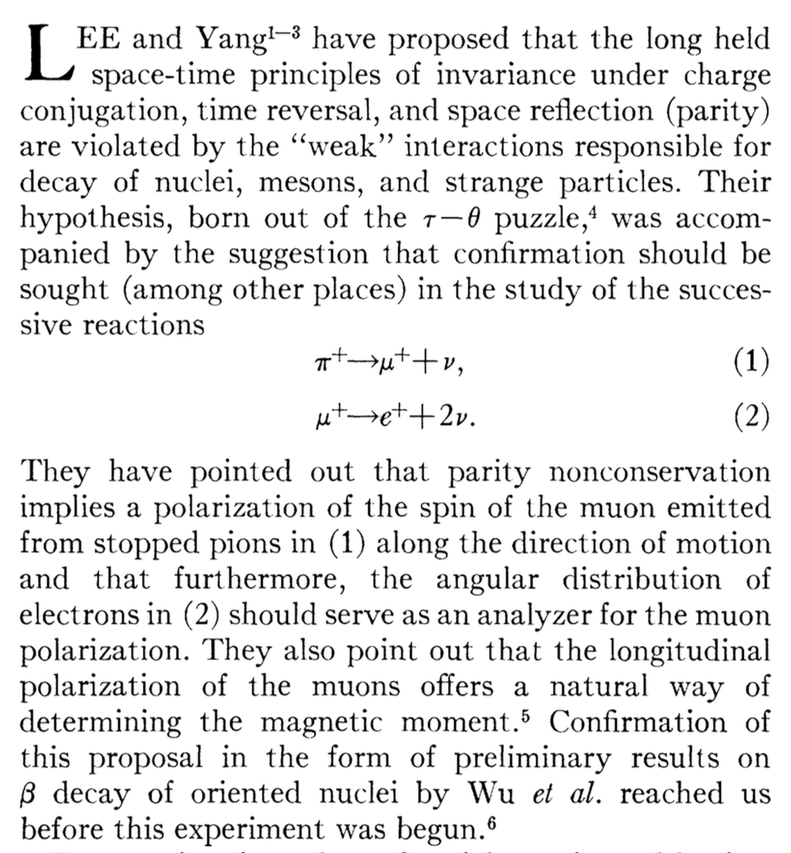
How did Muon get Polarized?
Parity Violation in Weak Interaction
My understanding is that:
If parity conserves, muons are able to adapt various spin direction along with direction of motion. (Symmetric under flipping of spatial coordinates)
S
S
Observations of the Failure of Conservation of Parity and Charge Conjugation in Meson Decays, R.L. Garwin, L.M. Lederman, M. Weinrich, Phys.Rev.105, 1415 (1957)

Slide 9
How did Muon get Polarized?
Parity Violation in Weak Interaction
If parity does not conserve, we get a specific spin direction along a direction of motion. In Muon’s case, we get this:
S
Along a direction, all muons are polarized in 1 particular spin direction. And also, spin direction is also opposite of translational momentum direction of the muon.
S
Observations of the Failure of Conservation of Parity and Charge Conjugation in Meson Decays, R.L. Garwin, L.M. Lederman, M. Weinrich, Phys.Rev.105, 1415 (1957)

Slide 10
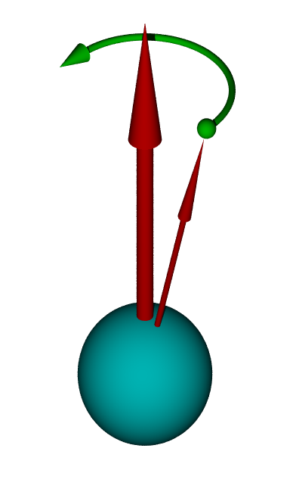


Larmor Precession and Relaxation
Once muons are implemented in the lattice site, it will respond to local magnetic field.
Implementation takes ~10 picosecond, depolarization occurs over microseconds
Muon spins will relax by aligning parallel and antiparallel to uniform fields or become randomized by local Gaussian field of lattice.
Time Evolution of Muon Polarization (Generalized to Tranverse Field)
$$P\left(t\right)= \frac{1}{3}e^{−σ_{damping}t}+\frac{2}{3}e^{−σ_{relax}t}Cos( γ_{μ}B_{local}t)$$
$ω=γ_{μ}B_{local}$ Precession Frequency
Image from http://upload.wikimedia.org/wikipedia/commons/9/93/Pr%C3%A4zession2.png

Slide 11
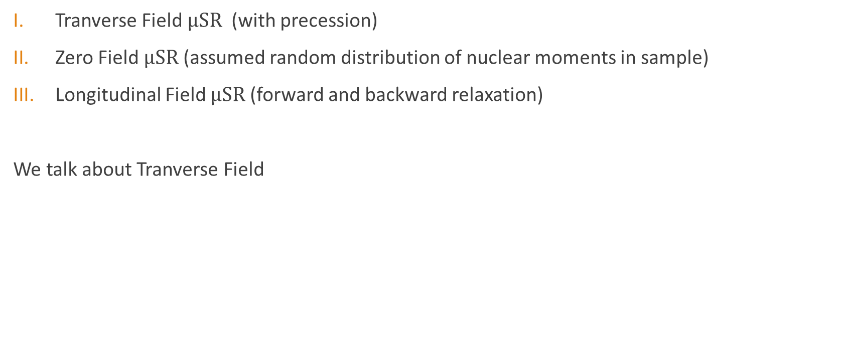

Three Type of Experiments
Tranverse Field $μSR$ (with precession)
Zero Field $μSR$ (assumed random distribution of nuclear moments in sample)
Longitudinal Field $μSR$ (forward and backward relaxation)
We talk about Tranverse Field
S
$$μ^{+}$$
Sample
Transverse external B-field
Positron Detector

Slide 12
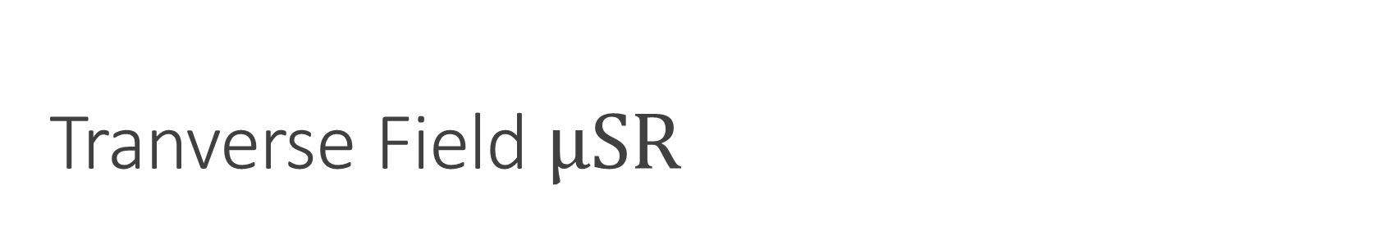
Tranverse Field $μSR$
Since muons are implanted uniformly in sample, direction & signal strength of positron emission can tell us the local microscopic field strength and field distribution of our sample.
S
$$μ^{+}$$
Sample
Transverse external B-field
Positron Detector

Slide 13
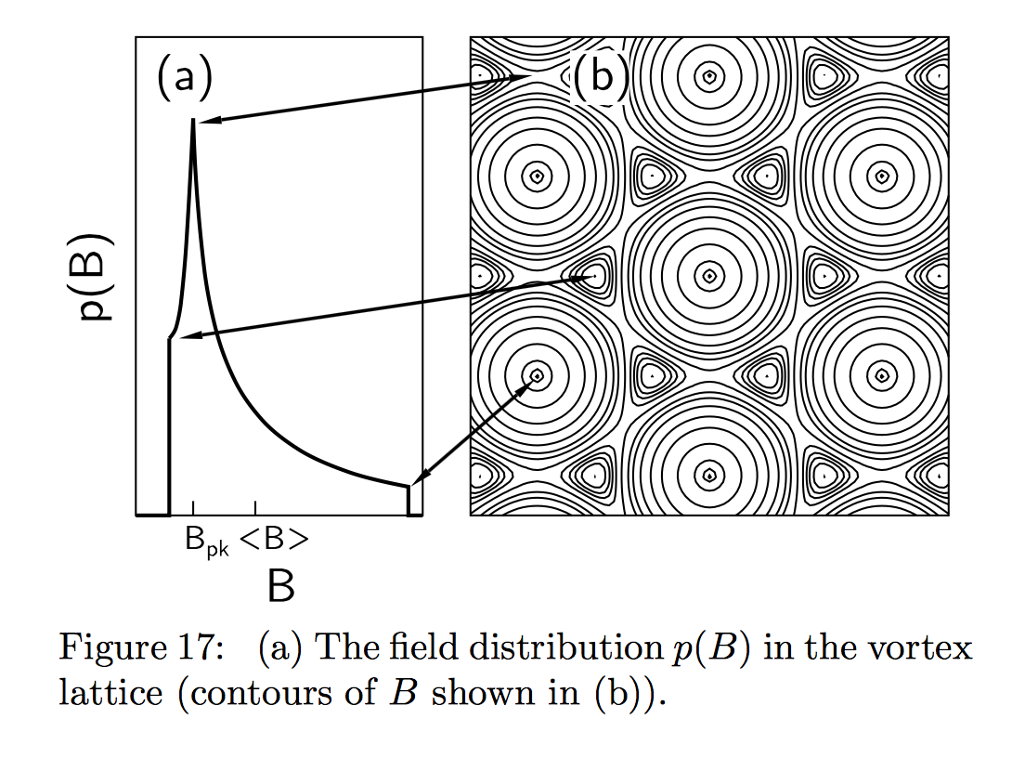
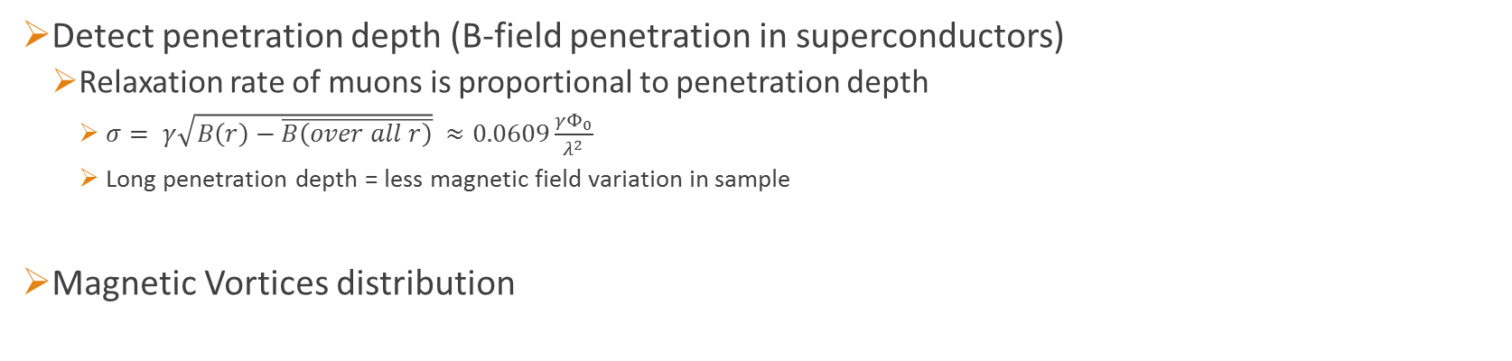
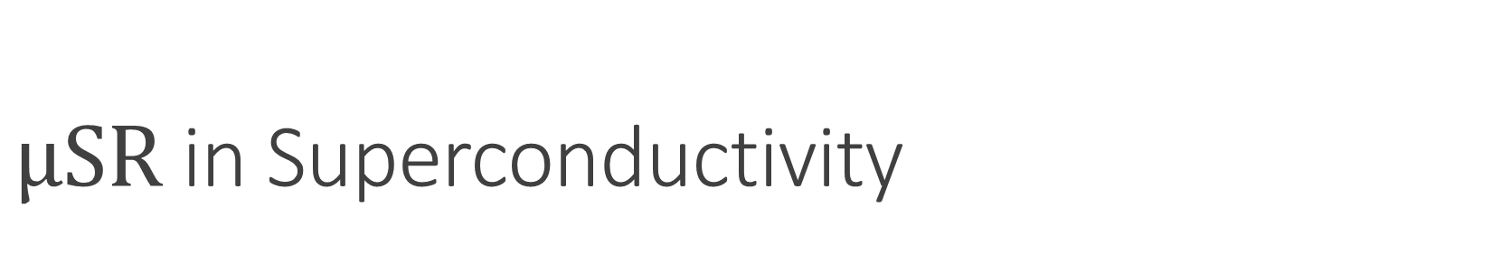
$μSR$ in Superconductivity
Detect penetration depth (B-field penetration in superconductors)
  Relaxation rate of muons is proportional to penetration depth
    $σ= γ\sqrt{B\left(r\right)−\overline{B\left(over all r\right)}} ≈0.0609\frac{γΦ_{0}}{λ^{2}}$
    Long penetration depth = less magnetic field variation in sample
Magnetic Vortices distribution
Spin-Polarized Muons in Condensed Matter Physics, S.J. Blundell, Contemp.Phys.40:175-192 (2002)

Slide 14
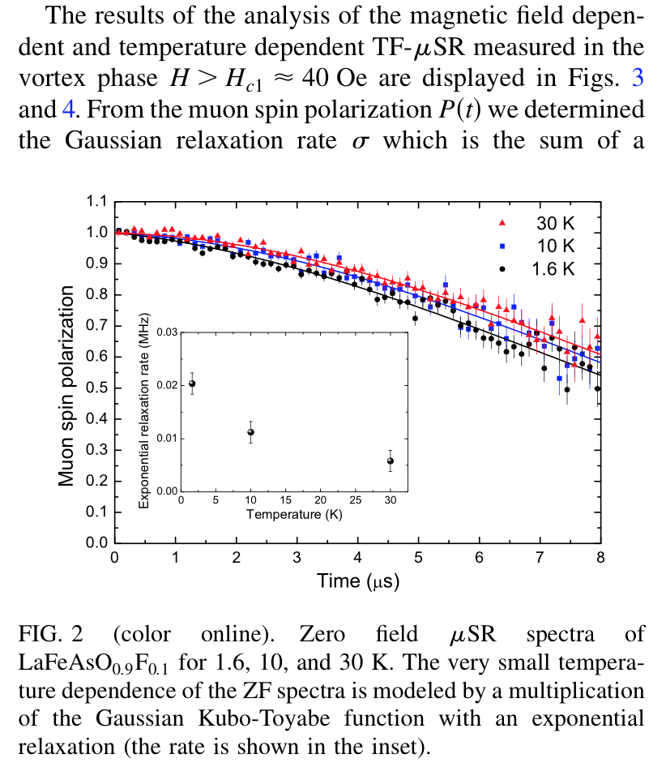
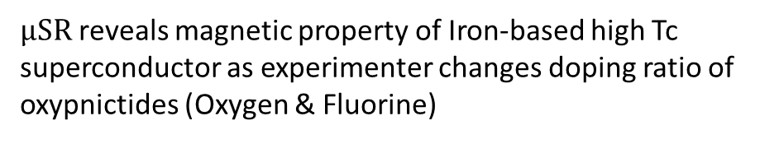
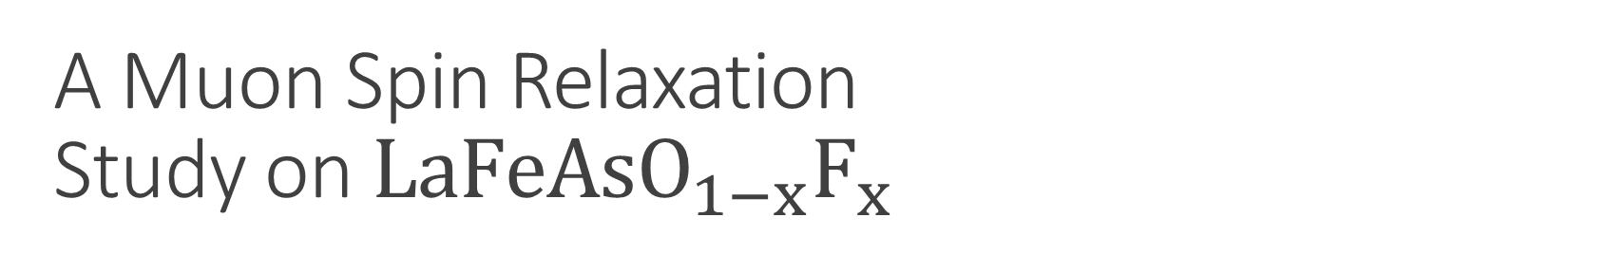
A Muon Spin Relaxation
Study on $LaFeAsO_{1−x}F_{x}$
$μSR$ reveals magnetic property of Iron-based high Tc superconductor as experimenter changes doping ratio of oxypnictides (Oxygen & Fluorine)
The study found:
Weak T-dependence of superfluid density below Tc/3
F-doping suppresses availability of SC ground states (spin-density state)
Quantitative measurement of penetration depth 254 nm for x = 0.1, 364 nm for x = 0.075
Very dilute superfluid

